Slide 1
ESQC 2024
Mathematical Methods Lecture 4
By Simen Kvaal

Slide 2
Vector Calculus

Slide 3
Functions of several variables
We turn to the study of functions between vector spaces:
A typical domain Ω:
Boxes in n
dimensions
Or more general shapes
Intervals

Slide 4
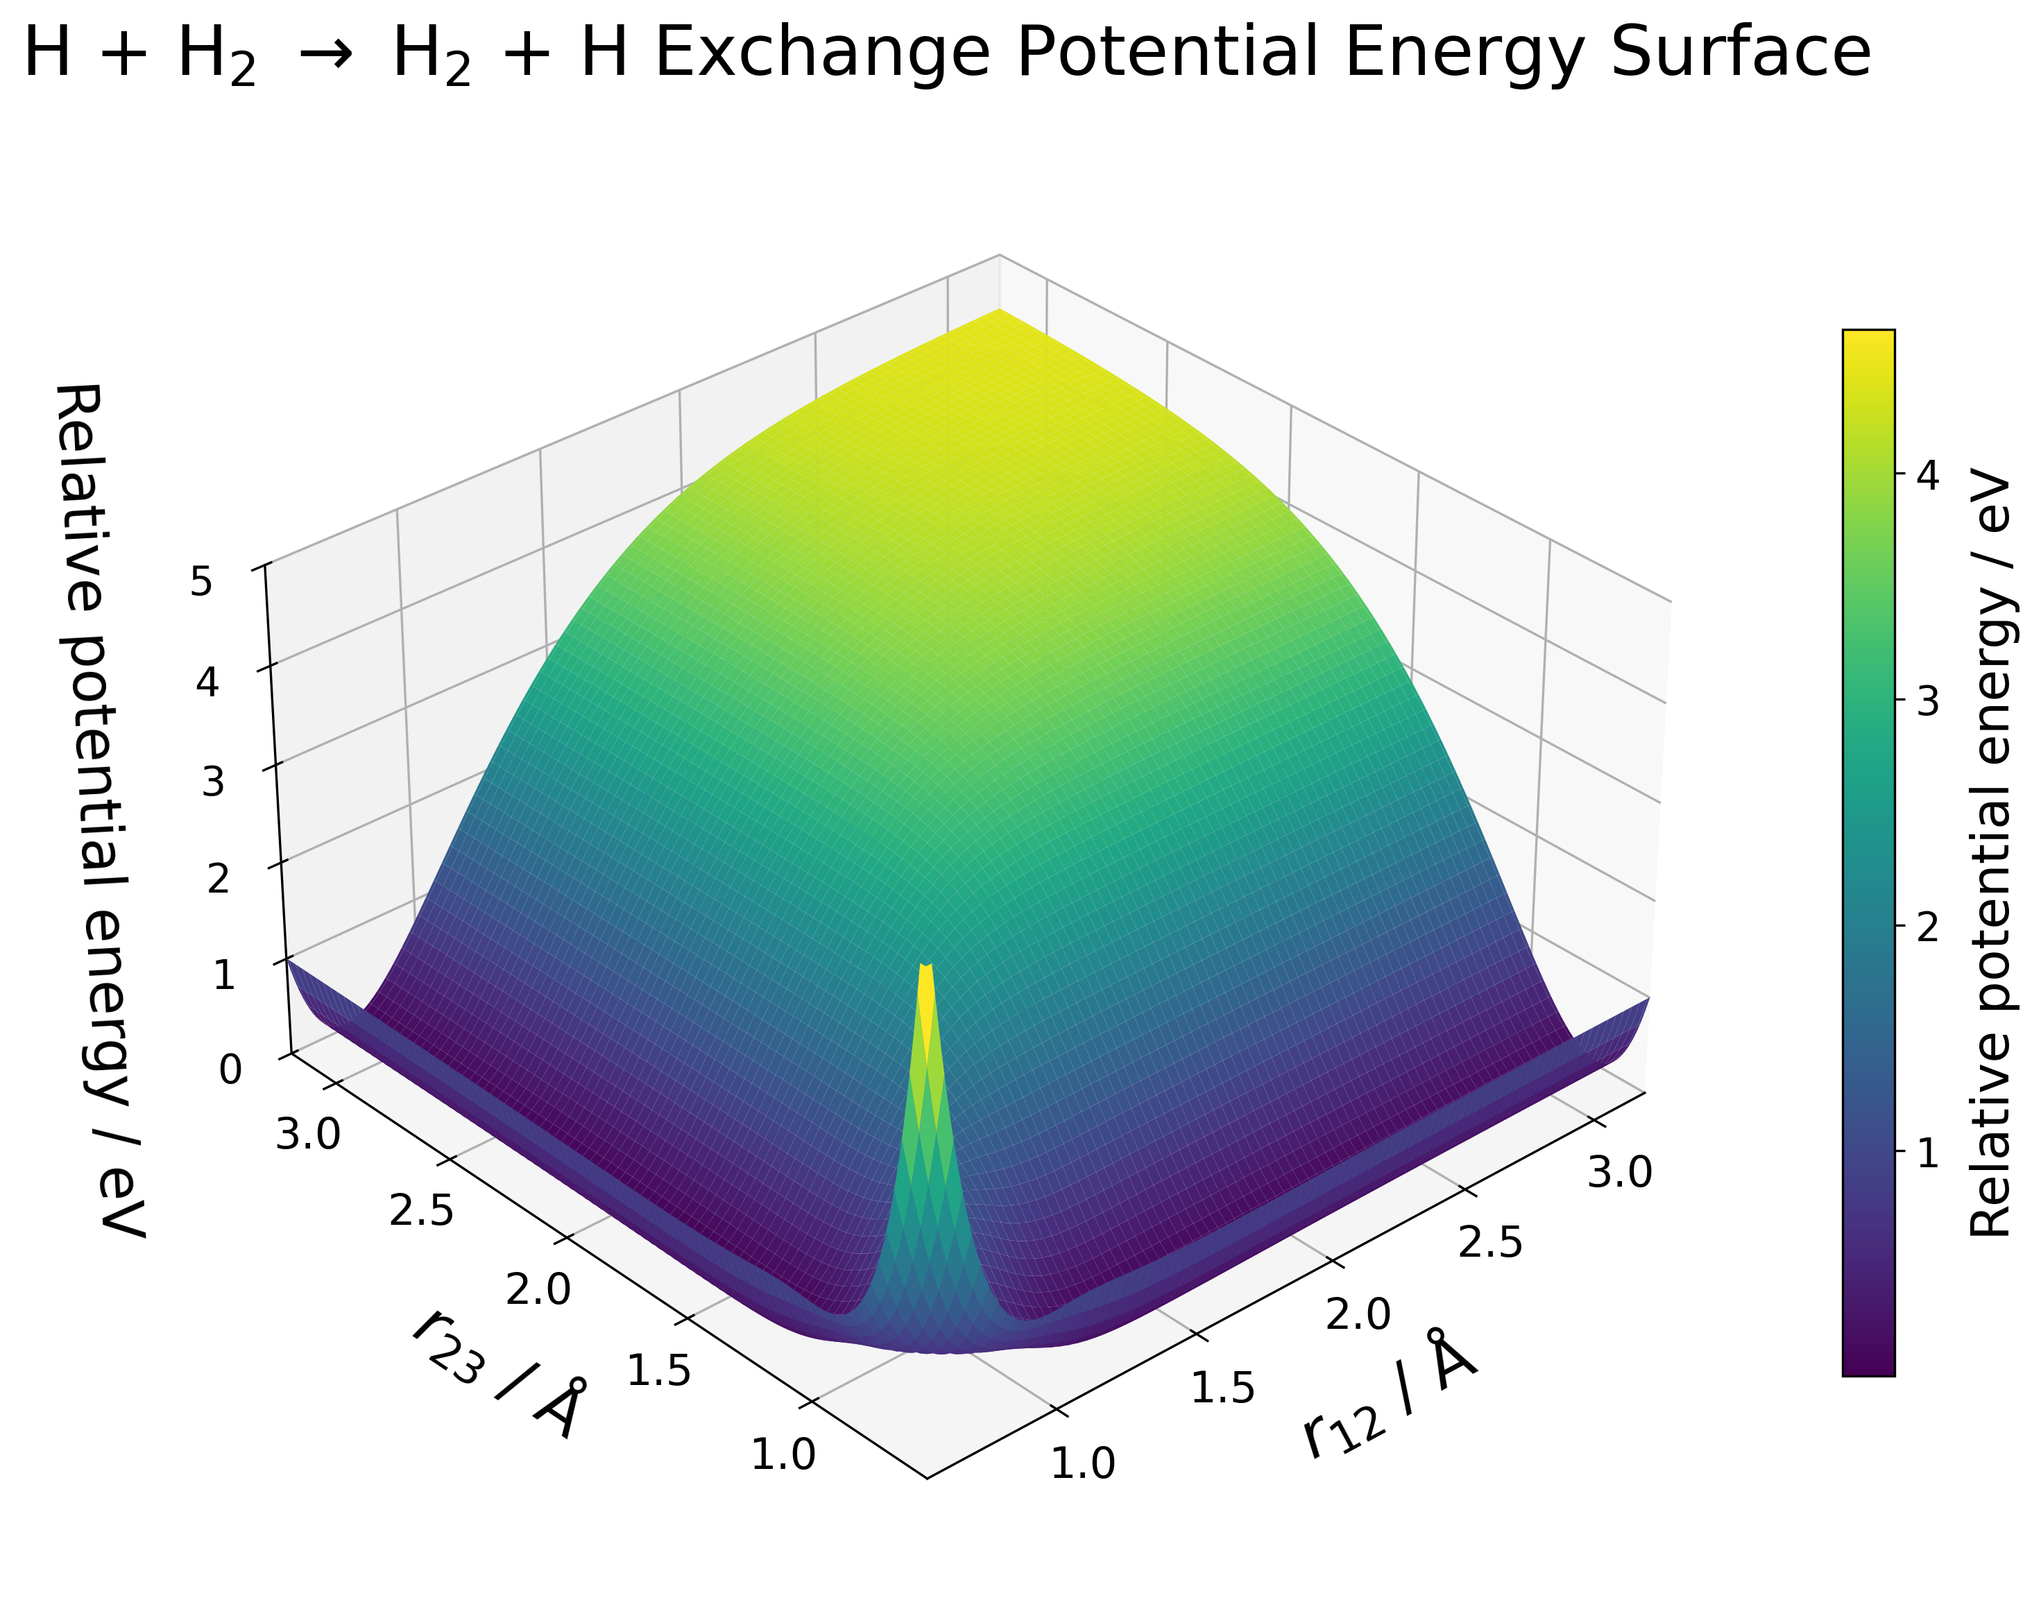

Examples
Curves:
Scalar fields:

Slide 5
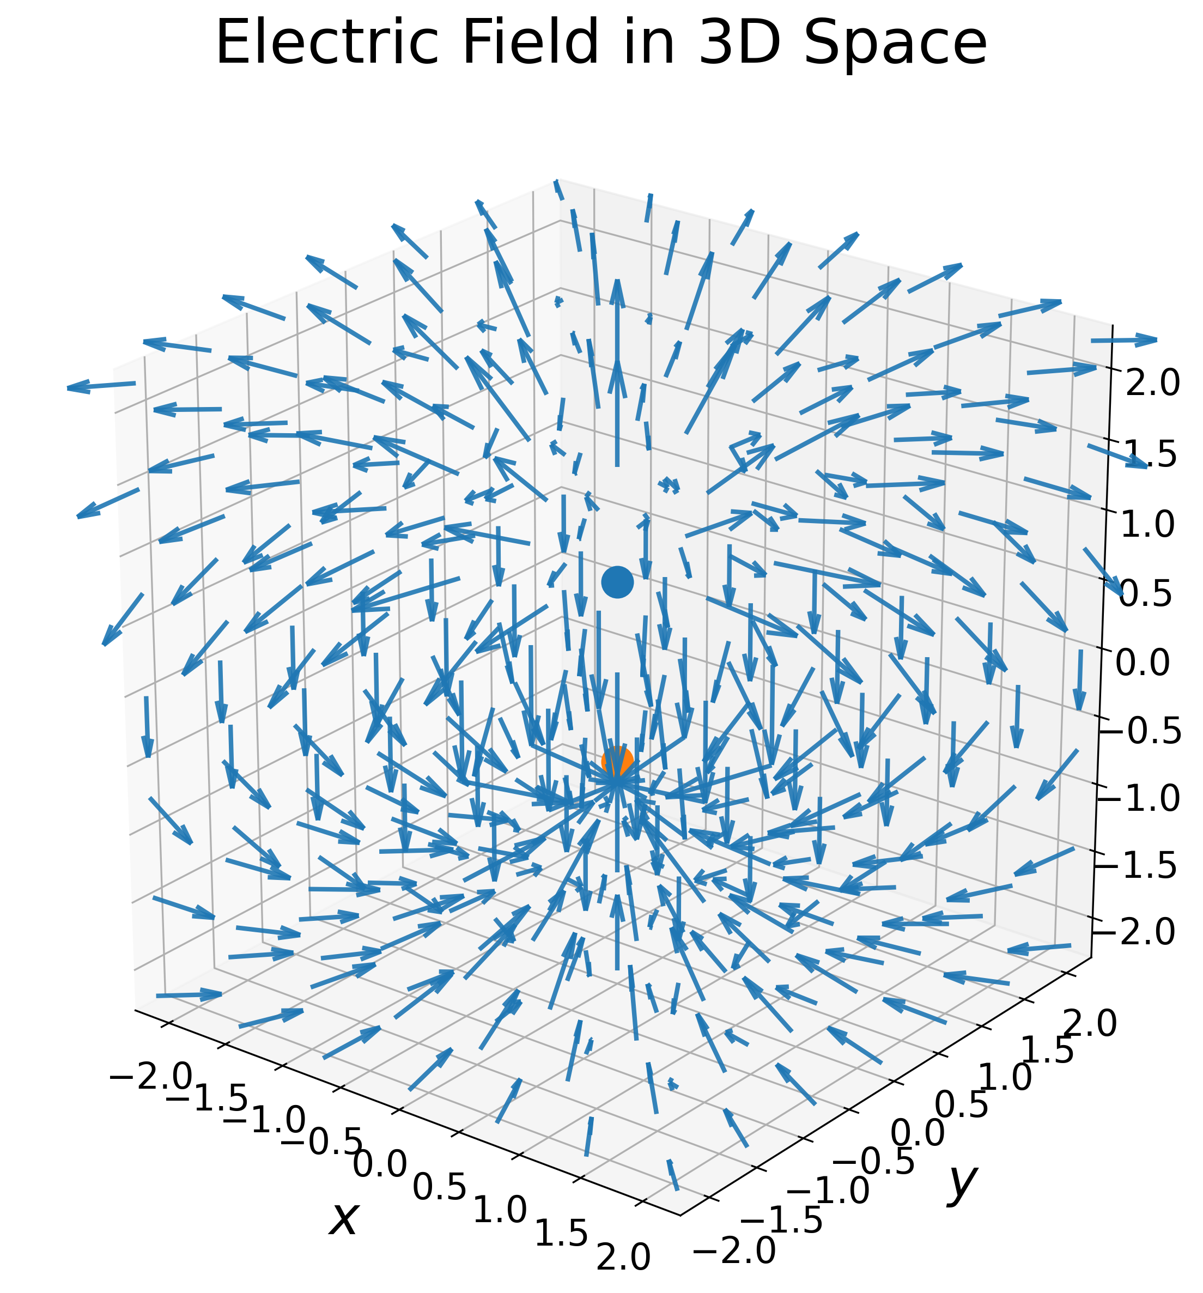
Examples 2
Vector fields:
3-vector fields appear in electromagnetism, fluid mechanics, ...

Slide 6
Partial derivatives
Extremely useful in optimization

Slide 7
What is the «slope» of a multivariable function?
In ordinary calculus:
But in 2D there are infinitely many directions to go.
For example, the coordinate directions:

Slide 8
Partial derivatives are ordinary derivatives of slices
Freeze a value for x₁ and define a slice:
The partial derivative is the ordinary derivative of the slice function:
Gradient:

Slide 9
Quick demo
lecture-4-hhh.ipynb

Slide 10
Directional derivatives
It is almost trivial to see that the directions 1 and 2 are arbitrary.
Why not choose another direction u?
This leads to the directional derivative
Derivative of a slice along u
Gradient contains all directional derivatives!
Notes:
Why does nature care about 1 and 2?

Slide 11
Meaning of the gradient
Directional derivative is a dot product:
The cosine is at max if angle is 0
The gradient points in the direction of steepest ascent
Demo: lecture-4-gradient.ipynb

Slide 12
Finding a local minimum: gradient flow
A local minimum must have:
If we always walk downhill, we must come to the bottom eventually!
Define a curve as follows:
Starting point for many algorithms: geometry opt., machine learning ...

Slide 14
Differentiability and linear algebra

Slide 15
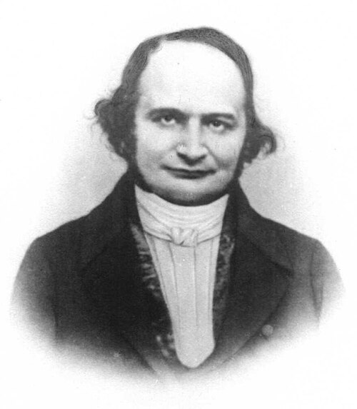
Looking back at calculus ...
The derivative had an important interpretation:
f’(x) was the best linear approximation near x
What replaces this in vector calculus?
Carl Gustaf Jacob Jacobi (1804-1851)
Jacobi = «Jacob’s»

Slide 16
The Jacobian matrix
A vector of scalar functions
We consdier now a general function
Each f_{i} now has a gradient. We obtain a matrix of partial derivatives
Jacobi’s’s matrix

Slide 17
From the Jacobian to linear approximation
We consider a single component f_{i}
Choose an origin and a direction in which to walk:
Compute the linear approximation of the slice function:
Matrix-vector product!

Slide 18
Small changes are linear
We obtain the vector equation:
A derivative in many dimensions is linear transformation!
h is a small change in the input
The second term is the small change in the function – which is a linear transformation!
Demo: lecture-4-parrot-transform.ipynb

Slide 19
What is a differentiable function?
It may be that the first-order Taylor approximation fails
For example: Partial derivatives may not exist!
We say that f is differentiable at x if the first-order Taylor expansion holds true!
f is differentiable

Slide 20
Example of a non-differentiable function
Run nondiff_function.py

Slide 21
Function composition and the chain rule
Recall the chain rule from calculus:
h is the composition of two functions:
Multivariable chain rule:
One linear transformation following after another
A main component of neural networks

Slide 22

Under a mathematical microscope, Vector Calculus is linear algebra.

Slide 23
The Hessian
The second derivative of a scalar function

Slide 24
Taylor expansion to one more order
We focus again on scalar functions
Jacobian = gradient in this case:
Repeated differentiation of the slice function leads to second order polynomial,
H_{f} is called the Hessian matrix

Slide 25
Hessian matrix
The Hessian matrix is the second derivative of a scalar function:
We say that f is twice differentiable if the Taylor approximation holds
In that case the Hessian is symmetric

Slide 26
Maxima, minima, saddle points

Slide 27
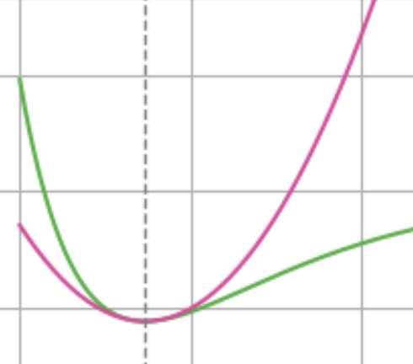
The Hessian encodes curvature
Recall from calculus, near a stationary point:
Multivariable case, stationary point:
Encodes the nature of the stationary point

Slide 28
Maxima, minima, saddle points 1
How does the second order term behave?
Since H is symmetric we have orthonormal basis of eigenvectors:
Exapansion of the small change in eigendirections

Slide 29
Maxima, minima, saddle points 2
All eigenvalues positive ⇒ local minimum
All eigenvalues negative ⇒ local maxium
Positive and negative eigenvalues ⇒ saddle point

Slide 30
Saddle point
Maximum

Slide 31
End of lecture 4
Other topics of vector calculus:
Constrained optimization and Lagrange multipliers
Integration and the theorems of Gauss and Stoke

